Slide 1

3.6 Sequential Circuits
41
Combinational logic circuits are perfect for situations when we require the immediate application of a Boolean function to a set of inputs.
There are other times, however, when we need a circuit to change its value with consideration to its current state as well as its inputs.
  These circuits have to “remember” their current state.
Sequential logic circuits provide this functionality for us.

Slide 2

3.6 Sequential Circuits
42
As the name implies, sequential logic circuits require a means by which events can be sequenced.
State changes are controlled by clocks.
  A “clock” is a special circuit that sends electrical pulses through a circuit.
Clocks produce electrical waveforms such as the one shown below.

Slide 3
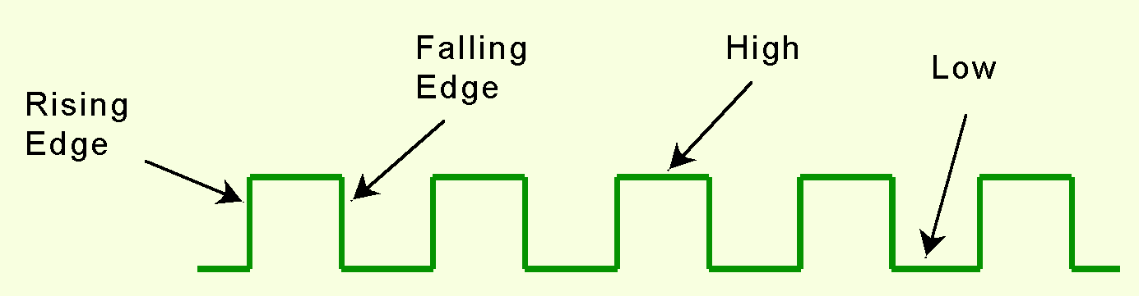
3.6 Sequential Circuits
43
State changes occur in sequential circuits only when the clock ticks.
Circuits can change state on the rising edge, falling edge, or when the clock pulse reaches its highest voltage.

Slide 4
3.6 Sequential Circuits
44
Circuits that change state on the rising edge, or falling edge of the clock pulse are called edge-triggered.
Level-triggered circuits change state when the clock voltage reaches its highest or lowest level.

Slide 5
3.6 Sequential Circuits
44b
In general, the circuits that we will look at will get their inputs on the rising edge.
By the time of the falling edge, the output will be stable and we can use it.

Slide 6
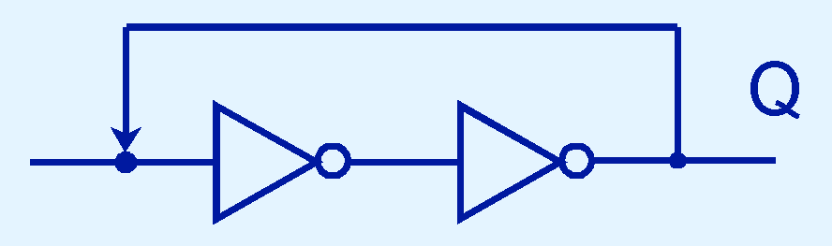
3.6 Sequential Circuits
45
To retain their state values, sequential circuits rely on feedback.
Feedback in digital circuits occurs when an output is looped back to the input.
A simple example of this concept is shown below.
  If Q is 0 it will always be 0. If it is 1, it will always be 1.

Slide 7
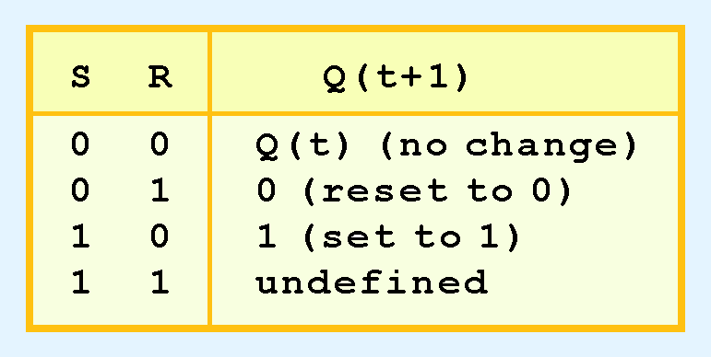
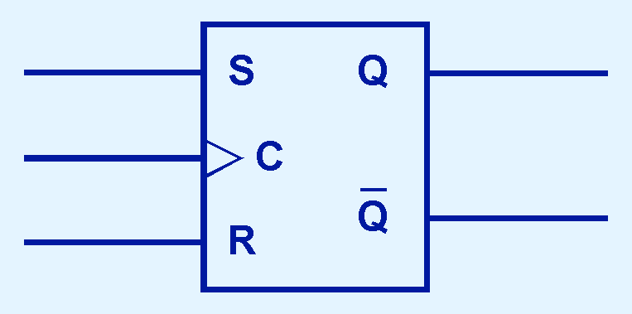
3.6 Sequential Circuits
46
You can see how feedback works by examining the most basic sequential logic components, the SR flipflop.
  The “SR” stands for set/reset.
The block diagram for an SR flipflop is shown below along with its characteristic table.

Slide 8
3.6 Sequential Circuits
47
The block diagram is the usual abbreviation for a circuit.
The characteristic table describes its behavior.
Q(t) means the value of the output at time t.
Q(t+1) is the value of Q after the next clock pulse.

Slide 9
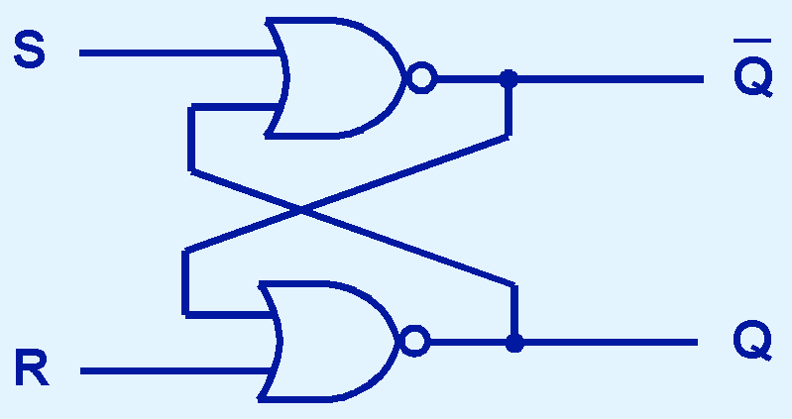
3.6 Sequential Circuits
47a
For those who are interested, the diagram below shows the internals of the SR flipflop.
To understand basic computer architecture, we can consider flipflops as fundamental units, just as we treat gates, i.e., we don’t need to know their internals.

Slide 10
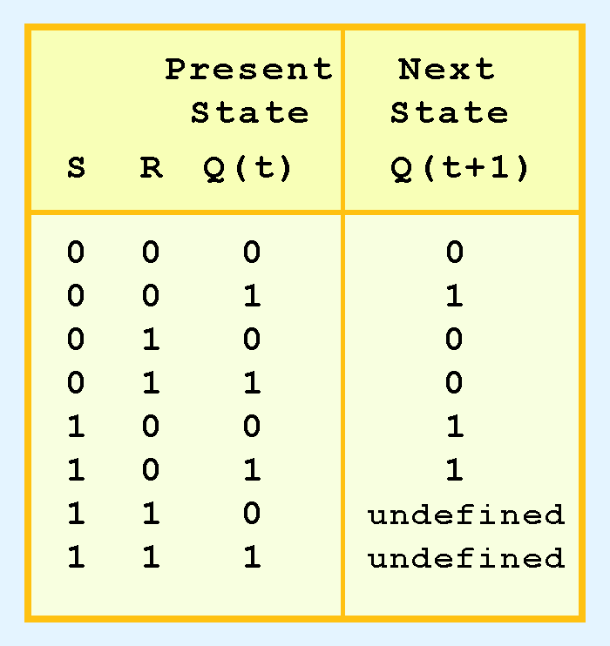
3.6 Sequential Circuits
48
The SR flipflop actually has three inputs: S, R, and its current output, Q.
Thus, we can construct a truth table for this circuit, as shown at the right.
Notice the two undefined values. When both S and R are 1, the SR flipflop is unstable.

Slide 11
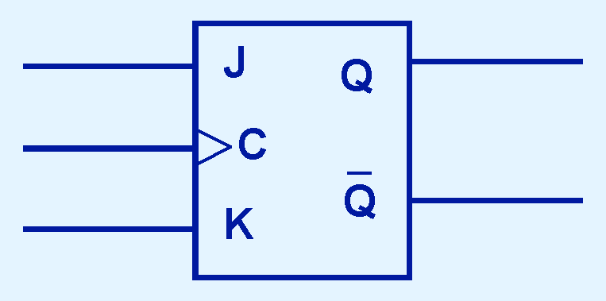
3.6 Sequential Circuits
49
If we can be sure that the inputs to an SR flipflop will never both be 1, we will never have an unstable circuit.
The SR flipflop can be modified to provide a stable state when both inputs are 1.
• This modified flipflop is called a JK flipflop, shown at the right.
- The “JK” is named after Jack Kilby.

Slide 12
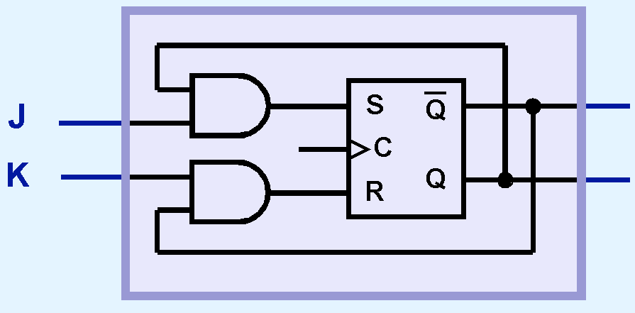
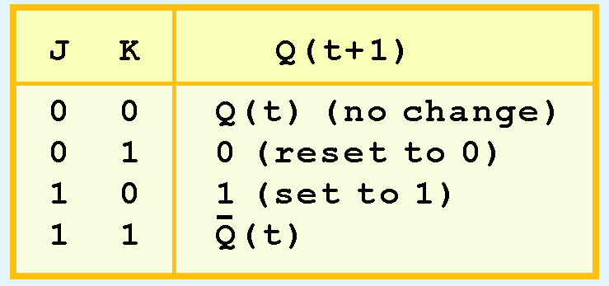
3.6 Sequential Circuits
50
At the right, we see how an SR flipflop can be modified to create a JK flipflop.
The characteristic table indicates that the flipflop is stable.
When J and K are both 1, the JK flipflop changes its output from the preceding value.
Q
Q’

Slide 13
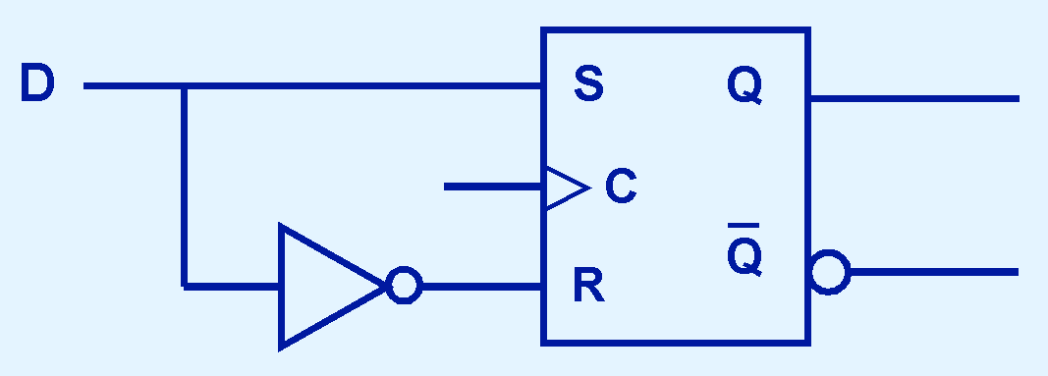
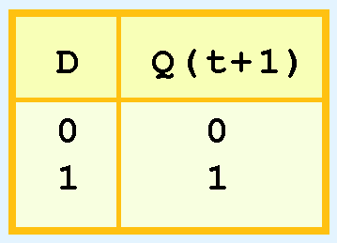
3.6 Sequential Circuits
51
Another modification of the SR flipflop is the D flipflop, shown below with its characteristic table.
The output of the D flipflop remains the same during subsequent clock pulses. The output changes only when the value of D changes.
A D flipflop is built by sending D and D’ into the S and R inputs of an SR flipflop.

Slide 14
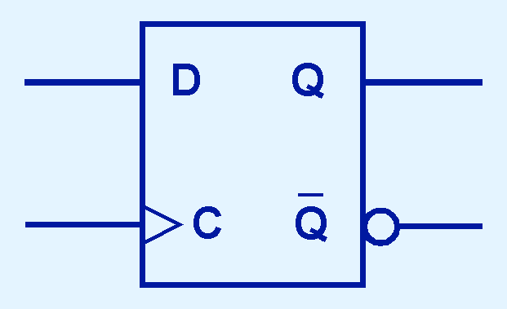
3.6 Sequential Circuits
52
Since its value is constant unless the input changes, the D flipflop is the fundamental circuit of computer memory.
  D flipflops are usually illustrated using the block diagram shown below.
  In addition to D, the clock input is needed as for any sequential circuit.
  It is convenient but not required to output both Q and Q’.

